Slide 1
Chapter 2 Database System Concepts and Architecture

Slide 2
Content
Data Model, Schema and Instance
Three schema architecture and data independence
Database languages & Interfaces
Database systems environment
Classification of DBMS

Slide 3
Data Models, Schemas, and Instances
Data abstraction : hiding the storage and data organization details & highlight essential features only.
data model—a concept that describes the structure of a database to achieve abstraction. Some data models also show manipulation operations.
Data Models can be divided into 3 categories:
Conceptual Data Model: defines WHAT the system contains.
entities, attributes & relationship
Created by stakeholders & data architects
Purpose: Create business rules
Logical Data Model: Defines HOW the system should be implemented regardless of the DBMS.
Done by BA and data architects
Physical Data Model: describes HOW the system will be implemented using a specific DBMS.
Create schemas , mappings
Created by DBA, developers
Actual implementation of DB

Slide 4
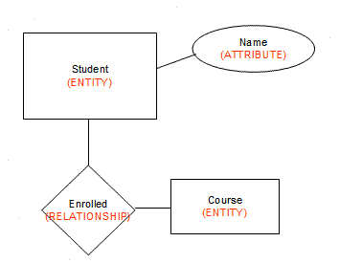
Data Models, Schemas, and Instances
Categories of Data Models:
High-level or conceptual data models such as entity–relationship model provide concepts that are easy for users to understand.
Conceptual data models use concepts such as entities, attributes, and relationships.
An entity represents a real-world object or concept, such as a student or a course.
An attribute further describes an entity, such as the student’s name or age.
A relationship among two or more entities represents an association among the entities, for example, a student is enrolled in a course.
Physical data models describe how data is stored as files in the computer by representing information such as record formats, record orderings, and access paths.

Slide 5
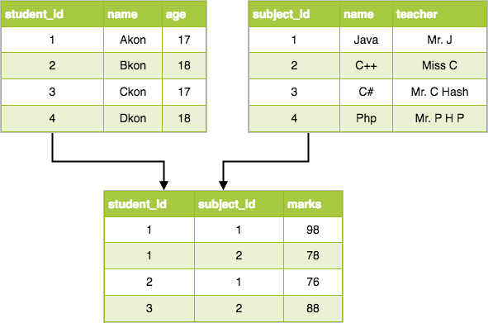
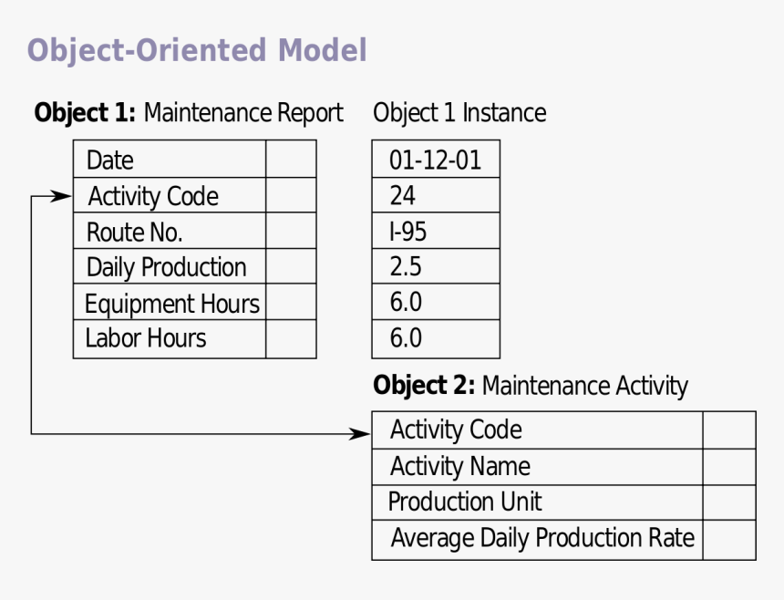
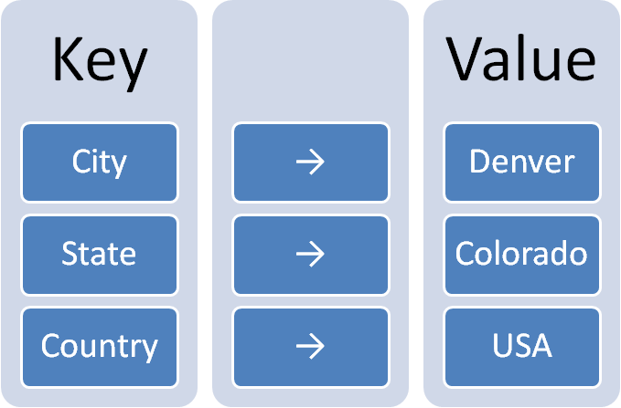
Data Models, Schemas, and Instances
Representational or implementation data models are used most frequently in traditional commercial DBMSs. These include the widely used relational data model.
Object data model is an example of a higher-level implementation data model that is closer to conceptual data models.
Self-describing data models - The data storage in these models combines the description of the data with the data values. These models include XML, key-value stores, and NOSQL systems

Slide 6
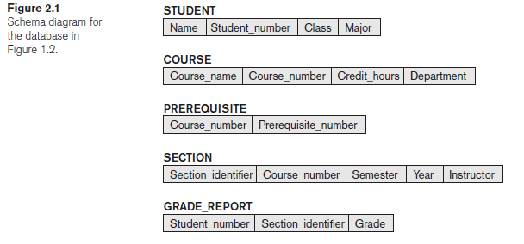
Data Models, Schemas, and Instances
Schemas, Instances, and Database State
The description of a database is called the database schema, which is specified during database design.
A displayed schema is called a schema diagram shown in figure. The diagram displays the structure of each record type but not the actual instances of records.
Each object in the schema—such as STUDENT or COURSE is a schema construct.
A schema diagram displays only some aspects of a schema, such as the names of record types and data items. Other aspects such as the data type of each data item nor the relationships among the various files are not specified.

Slide 7
Data Models, Schemas, and Instances
Schemas, Instances, and Database State
The actual data in a database may change quite frequently. For example, the database changes every time we add a new student or enter a new grade.
The data in the database at a particular moment in time is called a database state or snapshot.
Difference between database schema and database state.
When we define a new database, we specify its database schema only to the DBMS. At this point, the database state is the empty state.
Initial state - when the database is first populated with the initial data.
Current state – the state right now
Valid state — a state that satisfies the structure and constraints specified in the schema.
The schema is sometimes called the intension, and a database state is called an extension of the schema.
Instance – an individual record in a database
Schema evolution – very rare, but needed because of change in business requirements.

Slide 8
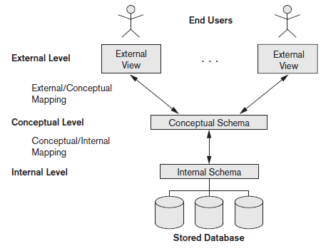
Three schema architecture and data independence
The Three-Schema Architecture
The goal of the three-schema architecture is data abstraction from user, i.e., user is independent of how & where data is stored.
Internal Level - The internal level has an internal schema, which describes the physical storage structure of the database.
The internal schema uses a physical data model and describes the complete details of data storage and access paths for the database.
Conceptual level - The conceptual level has a conceptual schema, which describes the structure of the whole database.
The conceptual schema hides the details of physical storage structures and concentrates on describing entities, data types, relationships, user operations, and constraints. e.g., ER model.
External level - The external or view level includes a number of external schemas or user views depending on user roles.
Each external schema describes the part of the database that a particular user group is interested in and hides the rest of the database from that user group.
The three schemas are only descriptions of data; the actual data is stored at the physical level only.

Slide 9
Three schema architecture and data independence
The Three-Schema Architecture
Request specified
on an external schema
The processes of transforming
requests and results between levels are called mappings.
Request transformed into conceptual schema
Request transformed into internal schema
Processing

Slide 10
Three schema architecture and data independence
Data Independence
Data independence – the capacity to change the schema at one level of a database system without having to change the schema at the next higher level.
Logical data independence is the capacity to change the conceptual schema without having to change external schemas .
We may change the conceptual schema (by adding a record type or data item), to change constraints, or to reduce the database (by removing a record type or data item).
After the conceptual schema changes, application programs that reference the external schema constructs must work as before.
E.g., Changes to constraints can be applied to the conceptual schema without affecting the external schemas or application programs.

Slide 11
Three schema architecture and data independence
Data Independence
Physical data independence is the capacity to change the internal schema without having to change the conceptual schema. Hence, the external schemas need not be changed as well.
Changes to the internal schema may be needed because some physical files were reorganized—for example, by creating additional access structures—to improve the performance of retrieval or update.
If the same data as before remains in the database, we should not have to change the conceptual schema.
Like changing file location/access paths, compressing and saving data records.
Which data independence is harder to achieve? Physical or logical? Why?
logical independence is difficult to achieve
Notes:
physical data independence exists in most databases and file environments where physical details, such as the exact location of data on disk, and hardware details of storage encoding, placement, compression, splitting, merging of records, and so on are hidden from the user. Applications remain unaware of these details.

Slide 12
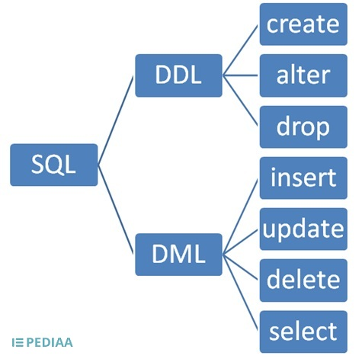
Database Languages and Interfaces
DBMS Languages
Data definition language (DDL):
Used by the DBA and by database designers
to define conceptual and internal schemas.
DBMS DDL compiler: process DDL statements in order to identify descriptions of the schema constructs and to store the schema description in the DBMS catalog.
Tasks of DDL: Create, Alter, Drop , Truncate, Rename.
Storage definition language (SDL): If a clear separation is maintained between the conceptual and internal levels, the DDL is used to specify the conceptual schema only and SDL is used to specify the internal schema.

Slide 13
Database Languages and Interfaces
DBMS Languages
View definition language (VDL):
to specify user views and their mappings to the conceptual schema.

Slide 14
Database Languages and Interfaces
DBMS Languages
Typical manipulations include
Retrieval, Insertion, Deletion, Modification of the data.
High-level/Nonprocedural DML:
many records in a single DML statement.
SQL is a High Level DML specifies which data to retrieve not how to retrieve it. Also called Declarative Languages.
Low-level/Procedural DML
use programming language constructs, such as looping, to retrieve and process each record from a set of records.
Programming languages used to write programs and access databases using DML statements are called host language: i.e. C++, java, python etc.
Notes:
In most relational DBMSs today, there is no specific language that performs the role of SDL. Instead, the internal schema is specified by a combination of functions, parameters, and specifications related to storage of files. These permit the DBA staff to control indexing choices and mapping of data to storage
. For a true three-schema architecture, we would need a third language, the view definition language (VDL), o specify user views and their mappings to the conceptual schema, but in most DBMSs the DDL is used to define both conceptual and external schemas. In relational DBMSs, SQL is used in the role of VDL to define user or application views as results of predefined queries.
In current DBMSs, a comprehensive integrated language is used that includes constructs for conceptual schema definition, view definition, and data manipulation. Storage definition is typically kept separate, since it is used for defining physical storage structures to fine-tune the performance of the database system, which is usually done by the DBA staff. A typical example of a comprehensive database language is the SQL relational database language, which represents a combination of DDL, VDL, and DML, as well as statements for constraint specification, schema evolution, and many other features. The SDL was a component in early versions of SQL but has been removed from the language to keep it at the conceptual and external levels only.

Slide 15
Database Languages and Interfaces
DBMS Languages
DCL(Data Control Language):
Deals with rights, permissions and other controls of the database system. i.e. GRANT, REVOKE
TCL(Transaction Control Language):
deals with the transaction within the database. i.e. COMMIT, ROLLBACK, SAVEPOINT

Slide 16
Database Languages and Interfaces
DBMS Interfaces
Menu-based Interfaces for Web Clients or Browsing. These interfaces present the user with lists of options (called menus) that lead the user through the formulation of a request. The query is composed step-by- step by picking options from a menu displayed by the system.
Apps for Mobile Devices. These interfaces present mobile users with access to their data. For example, banking, reservations, and insurance companies, provide apps that allow users to access their data through a mobile phone.
Forms-based Interfaces. A forms-based interface displays a form to each user. Users can fill out all of the form entries to insert new data.
Graphical User Interfaces. A GUI typically displays a schema to the user in diagrammatic form. The user then can specify a query by manipulating the diagram. In many cases, GUIs utilize both menus and forms.

Slide 17
Database Languages and Interfaces
DBMS Interfaces
Natural Language Interfaces. These interfaces accept requests written in English or some other language and attempt to understand them. A natural language interface usually has its own schema, which is similar to the database conceptual schema, as well as a dictionary of important words.
Example: Show me a list of all the customers in my database = Select CustomerID from Customers
Keyword-based Database Search. These are somewhat similar to Web search engines, which accept strings of natural language (like English) words and match them with documents at specific sites (for local search engines) or Web pages on the Web at large (for engines like Google or Ask). Based on keywords and ranking system.
Speech Input and Output. Applications with limited vocabularies, such as inquiries for telephone directory, flight arrival/departure, and credit card account information, are allowing speech for input and output to enable customers to access this information.

Slide 18
Database Languages and Interfaces
DBMS Interfaces
Interfaces for Parametric Users: Parametric users, such as bank tellers.
repetitive transactions such as account deposits or withdrawals, or balance inquiries.
Interfaces for the DBA: Privileged commands that can be used only by the DBA staff.
commands for creating accounts
setting system parameters
granting account authorization
changing a schema
reorganizing the storage structures of a database.

Slide 19
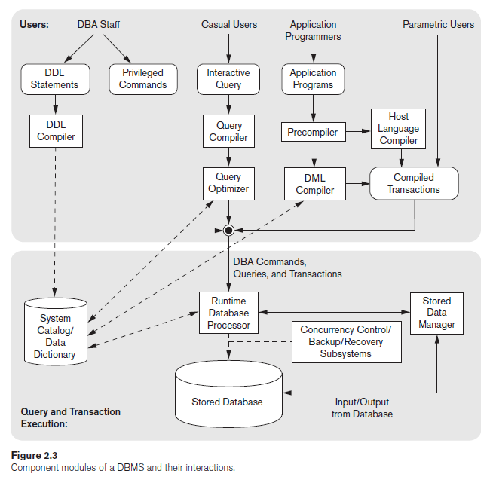
The Database System Environment

Slide 20
The Database System Environment
DBMS Component Modules
Top part of the figure refers to the various users of the database environment and their interfaces.
Lower part shows the internal modules of the DBMS responsible for storage of data and processing of transactions.
The database and the DBMS catalog are usually stored on disk. Access to the disk is controlled primarily by the operating system (OS), which schedules disk read/write.

Slide 21
The Database System Environment
DBMS Component Modules
USERS (top part)
Interfaces for the DBA staff
Casual users who work with interactive interfaces to make queries
Application programmers who create programs using some host programming languages
Parametric users who do data entry work by supplying parameters to predefined transactions.

Slide 22
The Database System Environment
DBMS Component Modules
DBA Staff
Works on defining the database and tuning it by making changes in schema using DDL and other privileged commands.
DDL compiler - processes schema definitions, specified in DDL and stores descriptions of the schemas (meta-data) in the DBMS catalog.
Catalog includes information such as the
names and sizes of files,
names and data types of data items,
storage details of each file,
mapping information among schemas,
and constraints.

Slide 23
The Database System Environment
DBMS Component Modules
Casual users
Interact using the interactive query interface for example any menu-based, form-based or mobile interactions.
Query compiler- queries are parsed and validated for correctness, the names of files and data elements, and so on by a query compiler that compiles them into an internal form.
This internal query is subjected to query optimization.
Query optimizer- concerned with the possible reordering of operations, elimination of redundancies, and use of efficient search algorithms during execution.
Consults the system catalog for physical information about the stored data.
Generates executable code that performs the necessary operations for the query and makes calls on the runtime processor.

Slide 24
The Database System Environment
DBMS Component Modules
Application programmers
Write programs in host languages such as Java, C, or C++ that are submitted to a precompile.
Precompiler - extracts DML commands from an application program written in a host programming language.
Commands are sent to the DML compiler for compilation into object code for database access. The rest of the program is sent to the host language compiler.
DML compiler – compiles DML commands into object codes
Canned transaction =
object code of DML cmds + object code of program
The executable code of canned transaction includes calls to the runtime database processor.
Each execution is considered to be a separate transaction.
An example is a bank payment transaction where the account number, payee, and amount may be supplied as parameters.

Slide 25
The Database System Environment
DBMS Component Modules
QUERY AND TRANSACTION EXECUTION
Runtime database processor
executes privileged commands,
executes the executable query plans,
executes the canned transactions with runtime parameters.
Works with the system catalog and may update it with statistics.
Works with the stored data manager, to perform read/write operations between the disk and main memory.
Concurrency control/Backup/Recovery systems integrated into the working of the runtime database processor for purposes of transaction management

Slide 26
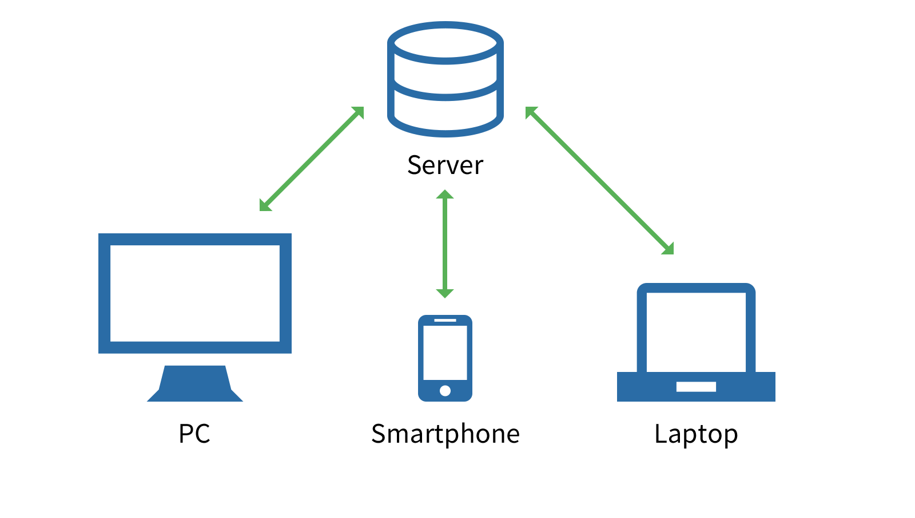
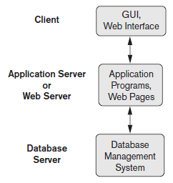
The Database System Environment
DBMS Component Modules
It is common to have the client program that accesses the DBMS running on a separate computer or device from the computer on which the database resides.
In many cases, the client accesses a middle computer, called the application server, which in turn accesses the database server.

Slide 27
The Database System Environment
Database System Utilities
Most DBMSs have database utilities that helps the DBA to manage the database system.
Loading –
used to load existing data files—such as text files or sequential files—into the database.
Usually, the current (source) format of the data file and the desired (target) database file structure are specified to the utility.
With the proliferation of DBMSs, transferring data from one DBMS to another is becoming common in many organizations. Some vendors offer conversion tools that generate the appropriate loading programs, given the existing source and target database storage descriptions (internal schemas).
Backup –
creates a backup copy of the database, usually by dumping the entire database onto tape or other mass storage medium.
The backup copy can be used to restore the database in case of catastrophic disk failure. Incremental backups are also often used, where only changes since the previous backup are recorded.

Slide 28
The Database System Environment
Database System Utilities
Database storage reorganization –
used to reorganize a set of database files into different file organizations and create new access paths to improve performance.
Performance monitoring –
monitors database usage and provides statistics to the DBA.
Other utilities may be available for:
sorting files,
handling data compression,
monitoring access by users,
and performing other functions.

Slide 29
Classification of Database Management Systems
Several criteria can be used to classify DBMSs.
1. Data model
Relational Data Model(SQL systems): commercial DBMSs
Big Data Systems/ Key-value Storage Systems/ Nosql Systems
Document-based
Graph-based
Column-based
Hierarchical Data Models: Legacy Data Models
Network Data Models: Legacy Data Models
Tree-structured Data Model: XML based
Explained in upcoming slides

Slide 30
Relational data model
Database as a collection of tables
Each table can be stored as a separate file
Uses SQL and support a limited form of user views
Object data model
defines a database in terms of objects, their properties, and their operations.
Objects with the same structure and behavior belong to a class
Classes are organized into hierarchies (or acyclic graphs).
Operations of each class are specified in terms of predefined procedures called methods
Notes:
Relational DBMSs have been extending their models to incorporate object database concepts and other capabilities; these systems are referred to as object-relational or extended relational systems.

Slide 31
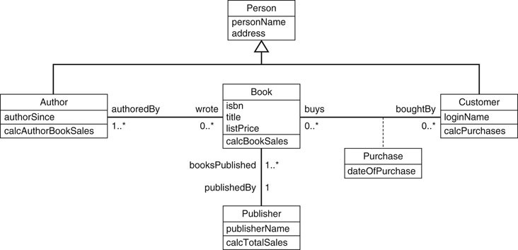
Object Data Model

Slide 32
Big data systems:
Key-Value:
Associates a unique key with each value
Provides very fast access to a value given its key.
Firebase from Google
Document Data Model
Stores the data as documents, which somewhat resemble complex objects.
Based on json (java script object notation)
i.e. MongoDB
Graph Data Model
Stores objects as graph nodes and relationships among objects as directed graph edges.
i.e. Neo4j
Column-based Data Models
Store the columns of rows clustered on disk pages for fast access
Allow multiple versions of the data.
i.e. Hbase
Notes:
Big data systems are based on various data models, with the following four data models most common.
The key-value data model associates a unique key with each value (which can be a record or object) and provides very fast access to a value given its key.
The document data model is based on JSON (Java Script Object Notation) and stores the data as documents, which somewhat resemble complex objects.
The graph data model stores objects as graph nodes and relationships among objects as directed graph edges.
Finally, the column-based data models store the columns of rows clustered on disk pages for fast access and allow multiple versions of the data.

Slide 33
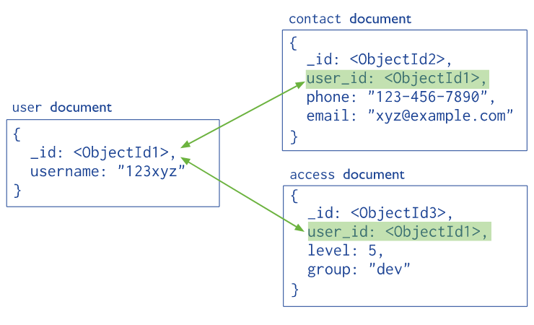
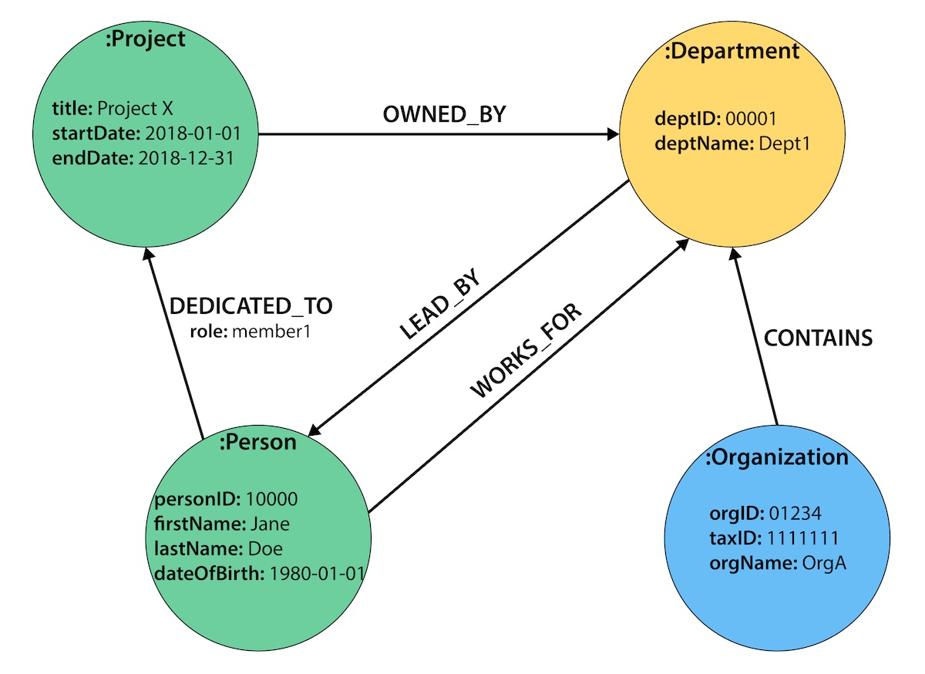
Document Model
Graph Data Model
Account number | Last name | First name | Purchase (in dollars)
0411 | Moriarty | Angela | 52.35
0412 | Richards | Jason | 325.82
0413 | Diamond | Samantha | 25.50
Column data model

Slide 34
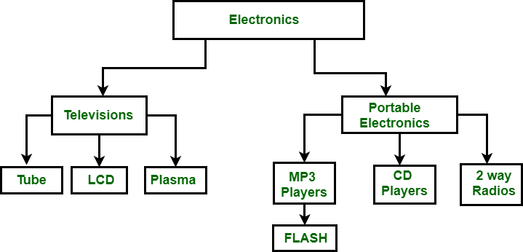
Hierarchical Data Model :
It organizes data in the tree-like structure.
Hierarchical model consists of the following :
It contains nodes which are connected by branches.
The topmost node is called the root node.
Each node has exactly one parent.
One parent may have many child.

Slide 35
Classification of Database Management Systems
2. Number of users supported by the system:
Single-user systems: support only one user at a time.
Multiuser systems. Multiple users at a time. Majority of databases are multiuser systems.
3. Number of sites over which the database is distributed.
Centralized: data is stored at a single computer site; can support multiple users.
Distributed DBMS (DDBMS): have the actual database and DBMS software distributed over many sites connected by a computer network. i.e. Big Data Systems
Notes:
Centralized: data is stored at a single computer site; can support multiple users.
Distributed DBMS (DDBMS): have the actual database and DBMS software distributed over many sites connected by a computer network.
Big data systems are often massively distributed, with hundreds of sites. The data is often replicated on multiple sites so that failure of a site will not make some data unavailable.

Slide 36
Classification of Database Management Systems
Distributed DBMSs:
Homogeneous DDBMSs: same DBMS software at all the sites
Heterogeneous DDBMSs: use different DBMS software at each site.
cost
Additional cost for accessing additional features. i.e. data warehousing, data mining, maintenance etc.
Examples of free relational DBMSs: MySQL, PostgreSQL, others
Open source (free) DBMS products like MySQL and PostgreSQL that are supported by third-party vendors with additional services.
Some license limits the number of concurrent users or the number of user seats at a location.
Standalone single-user versions of some systems like Microsoft Access are sold per copy or included in the overall configuration of a desktop or laptop.
Notes:
It is also possible to develop middleware software to access several autonomous preexisting databases stored under heterogeneous DBMSs. This leads to a federated DBMS (or multi database system), in which the participating DBMSs are loosely coupled and have a degree of local autonomy.
Cost Range: from free open-source systems to configurations costing millions of dollars
Examples of free relational DBMSs: MySQL, PostgreSQL, others
Commercial DBMS offer additional specialized modules, e.g. time-series module, spatial data module, document module, XML module
These offer additional specialized functionality when purchased separately
Sometimes called cartridges or blades
Different licensing options: site license, maximum number of concurrent users (seat license), single user, etc.

